Slide 1

SAT & ACT Analysis
Prepared by: Esther Leung

Slide 2
Agenda
Problem Statement
Data & Data Processing
Exploratory Data Analysis
Conclusion & Recommendations
Data Limitations

Slide 3
Problem Statement
Following the change in the SAT format in March 2016, the College Board is keen to identify ways to improve SAT participation rates.
In this presentation, we perform trend analysis to explore relationships between participation rates and average test scores by states, and incorporate additional market analysis, to provide recommendations to improve SAT participation rate.

Slide 4
Data
In this analysis, the following data for SAT and ACT in the year 2017 and 2018 are analysed:
Participation Rate of each test by state
Average Subject and Total/ Composite Test Scores of each test by state
SAT | ACT
Math | English
Evidence-based Reading & Writing | Math
Total | Reading
 | Science
 | Composite

Slide 5
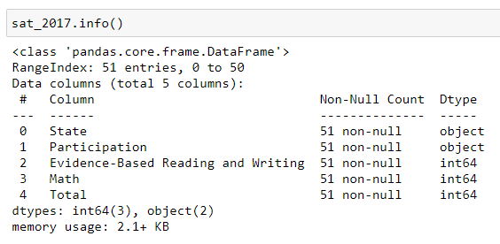

Data Processing
The following data cleaning was done before Exploratory Data Analysis:
The 2017 datasets were imported and checked for the respective data types
For participation rate, the datatype is object, which should be converted to integer (after removal of ‘%’ character)
Notes:
Sources:
https://blog.collegevine.com/here-are-the-average-sat-scores-by-state/
https://www.act.org/content/dam/act/unsecured/documents/cccr2017/ACT_2017-Average_Scores_by_State.pdf

Slide 6
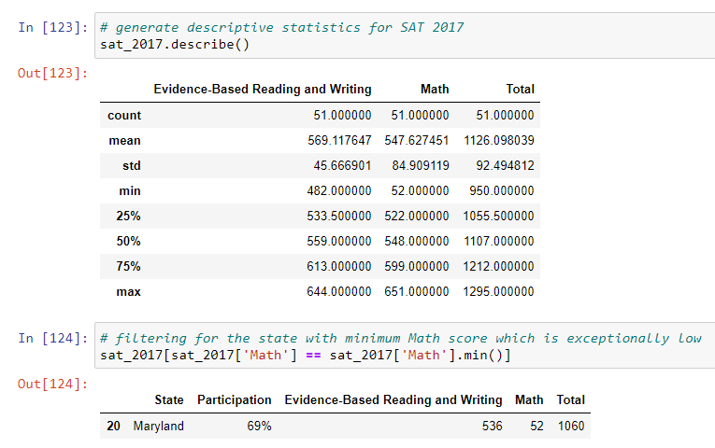
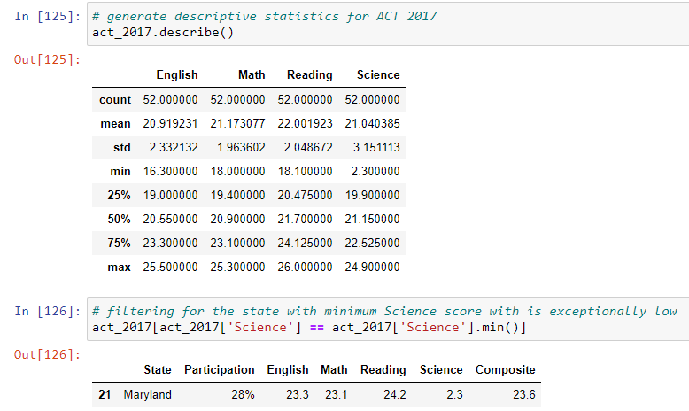
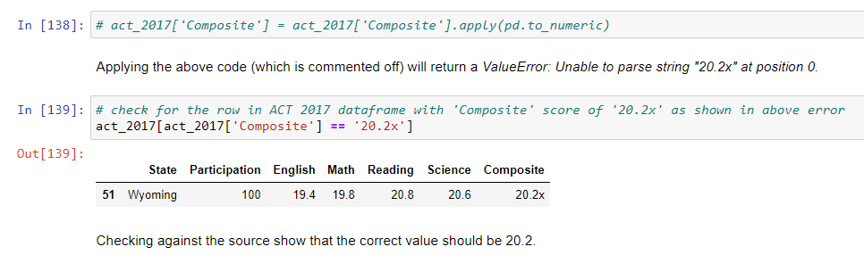
Data Processing (continued)
The 2017 datasets were verified against data sources available online: SAT Data Source
ACT Data Source
Data errors were spotted for Maryland’s Math score in SAT 2017, Maryland’s Science score in ACT 2017, and Wyoming’s ACT Composite score in 2017.
Data errors identified were fixed accordingly and data was converted to appropriate datatypes.
Notes:
Sources:
https://blog.collegevine.com/here-are-the-average-sat-scores-by-state/
https://www.act.org/content/dam/act/unsecured/documents/cccr2017/ACT_2017-Average_Scores_by_State.pdf

Slide 7
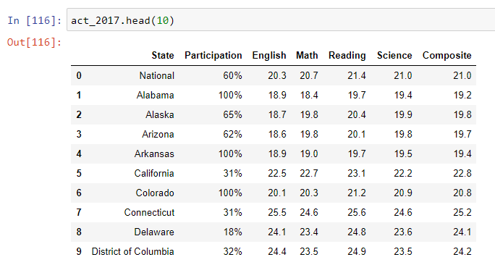
Data Processing (continued)
Additional row of data in ACT 2017 for National aggregates was removed.
The 2018 datasets were imported and aligned to similar format as the 2017 data.
The 4 datasets were merged into a final dataset for Exploratory Data Analysis.

Slide 8
Exploratory Data Analysis

Slide 9
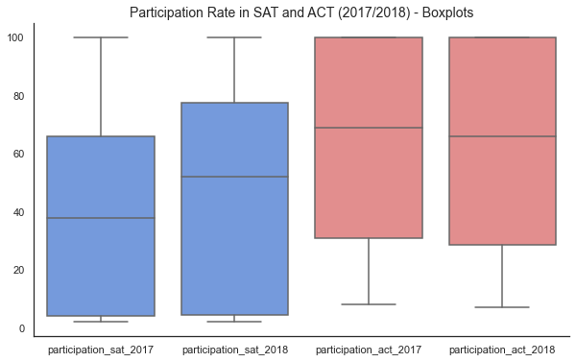
In both 2017 and 2018, the ACT had a higher median participation rate than the SAT.

Slide 10
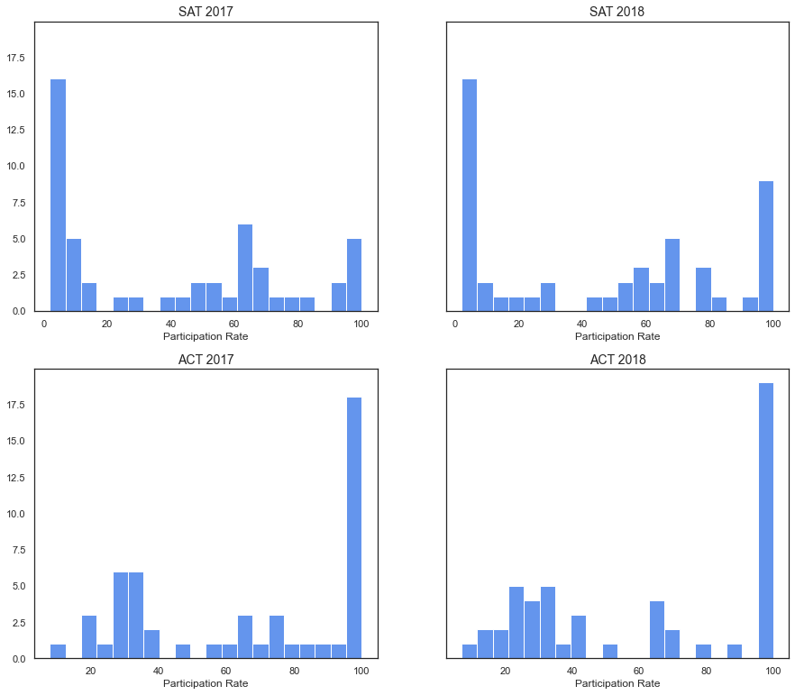
A third of the states had 100% ACT participation in 2017 and 2018. Mirroring this, a similar proportion of states have low SAT participation rate in both years.
Notably, the number of states with strong SAT participation has increased in 2018.

Slide 11
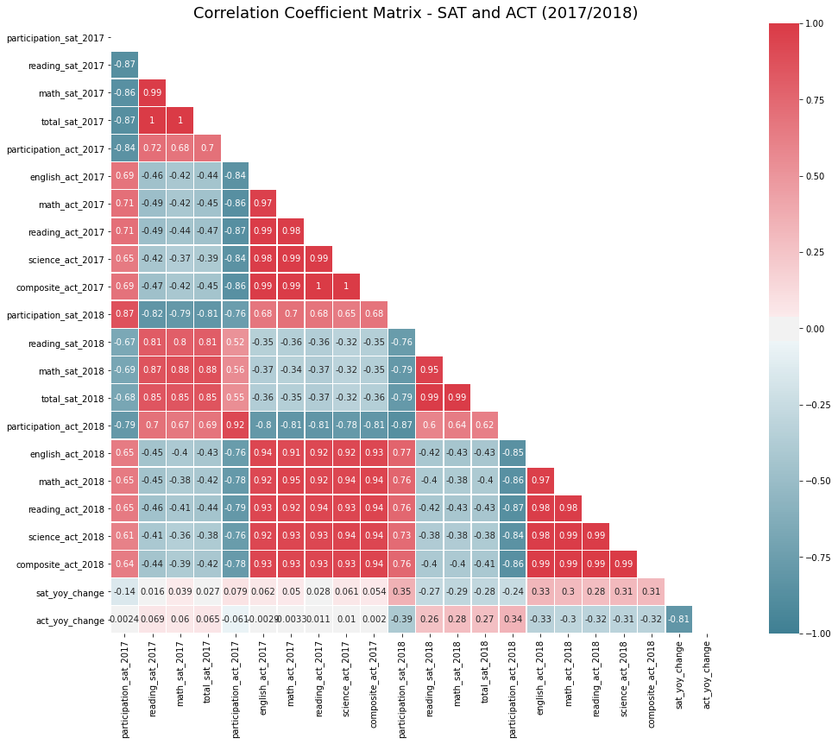
No evidence of prior year SAT test score positively correlating to SAT participation
High SAT scores in 2017 does not correlate to high SAT participation rate in 2018. In fact, negative correlation is observed.
Similarly, low ACT scores in 2017 also does not correlate to high SAT 2018 participation.

Slide 12
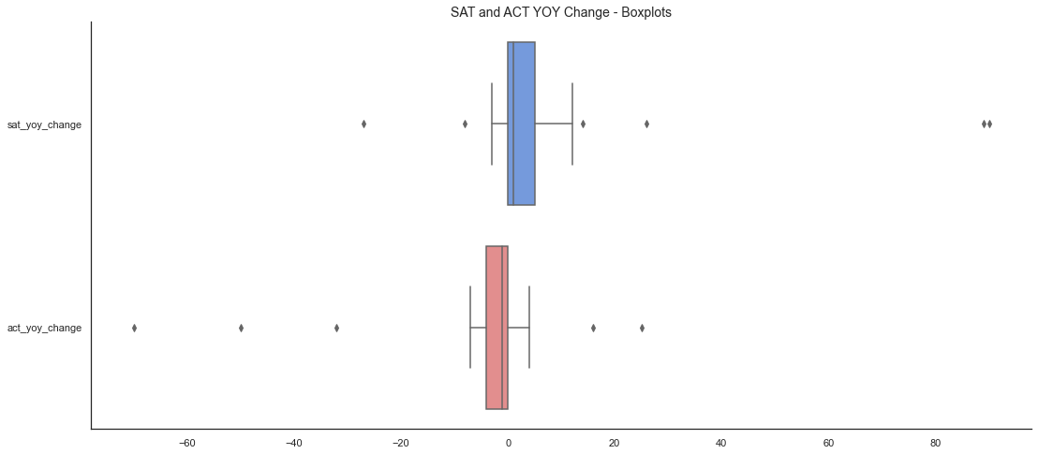
Sharp increase in SAT participation rate seen for Colorado and Illinois, along with decline in ACT participation, indicates conversion from ACT to SAT. Rhode Island also saw a notable increase in SAT participation.
Colorado
SAT yoy change: +89%
ACT yoy change: -70%
Illinois
SAT yoy change: +90%
ACT yoy change: -50%
Rhode Island
SAT yoy change: +26%
ACT yoy change: -6%
SAT yoy change
= SAT participation 2018 - SAT participation 2017
ACT yoy change
= ACT participation 2018 - ACT participation 2017

Slide 13
State contracts and state funded test are key drivers of SAT participation rate in Colorado, Illinois and Rhode Island in 2018.
In 2017-2018, 10 states (Colorado, Connecticut, Delaware, Idaho, Illinois, Maine, Michigan, New Hampshire, Rhode Island, and West Virginia) and the District of Columbia covered the cost of the SAT for all their public school students.
Three years prior to that, only three states and the District of Columbia did so.
Source:
https://www.edweek.org/ew/articles/2018/10/31/sat-scores-rise-as-number-of-test-takers.html
https://www.chicagotribune.com/news/ct-illinois-chooses-sat-met-20160211-story.html
https://co.chalkbeat.org/2015/12/23/21092477/goodbye-act-hello-sat-a-significant-change-for-colorado-high-schoolers
https://www.edweek.org/ew/section/multimedia/states-require-students-take-sat-or-act.html

Slide 14
Conclusion & Recommendations

Slide 15
Conclusion & Recommendation
State contracts and state funded test are key drivers to SAT participation.
It is recommended that the College Board focuses on developing partnerships with states that do not have any prevailing contract awarded to either the College Board or ACT, and currently have low SAT participation in 2018. Examples of such states include Iowa, Kansas, and South Dakota. Priority can be placed on Iowa, which has a higher population.
On a longer term, the College Board may wish to explore states that already mandate state-wide ACT participation and lobby the education boards to switch to the SAT when their existing state contract is about to expire. These states are more likely to have the required infrastructure and resources to support state-wide test arrangement. Examples of such states include Montana, Utah and Wyoming.

Slide 16
Data Limitation
Statistical inferences for national population based cannot be made based on the 51 state samples as the samples are not randomly drawn.
Given data availability for the year 2017 and 2018 only, and not for subsequent or preceding years, this trend analysis is limited to these 2 years rather than offering a longitudinal view.
With the aggregation of data by state, there are only 51 data points per dataset to work with, and more granular analyses on a county or school level cannot be performed.
Hence, the conclusions and recommendations made are subjected to these data limitations.

